Slide 1
COVID-19: Uncovering Important Social Health Factors
Jasmine Bains
Research Analyst
Beyond GDP: Measuring Well-Being and Quality of Life in a Time of COVID-19
June 8, 2020

Slide 3
How CHI Thinks About Well-Being
Increase visibility of social factors
Use analysis to track well-being
Colorado Health Access Survey
Root Causes
Social Health Information Exchange

Slide 4
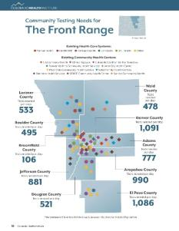
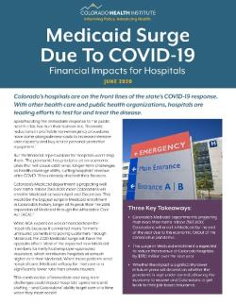
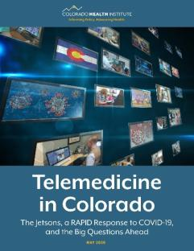
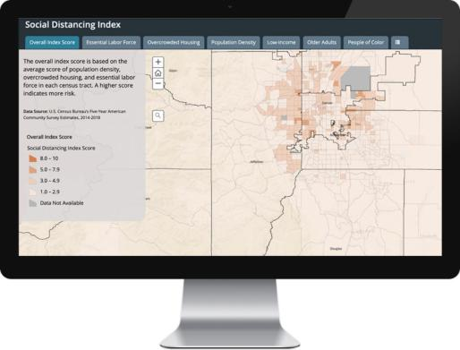
CHI’s Response During COVID-19
Social Distancing Index
Telemedicine
Metro Denver Partnership for Health
Insurance Coverage and Access to Care

Slide 5
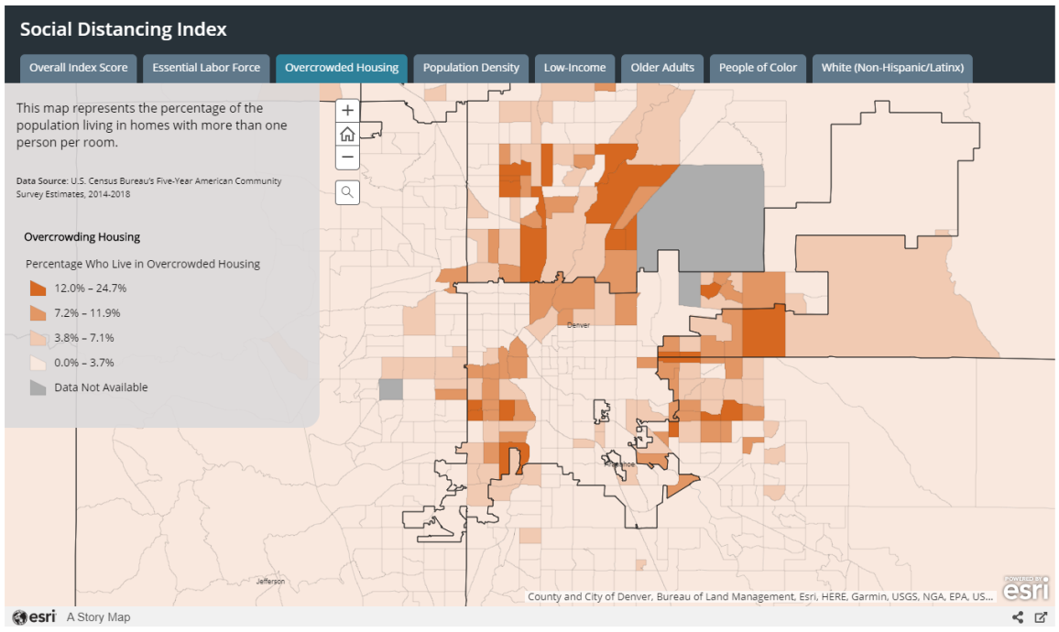
Social Distancing Index

Slide 6
Telemedicine in Colorado
Digital divide
Location matters: rural vs. urban

Slide 7
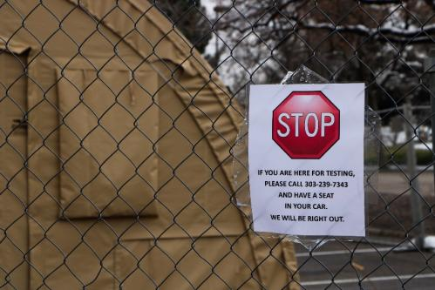
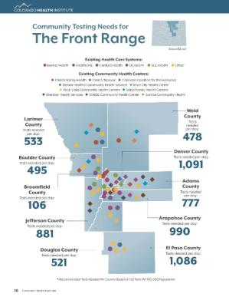
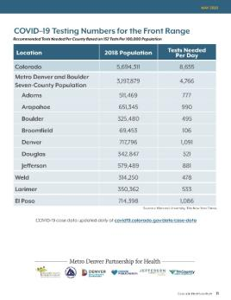
Metro Denver Partnership for Health
Testing needs in Colorado counties
How to reach vulnerable populations
Collaboration between local leaders

Slide 8
Insurance Coverage & Access
Expecting Medicaid enrollment growth to be larger than ACA expansion
Health insurance impacts access to care

Slide 9
Jasmine Bains
@jbains0811
bainsj@coloradohealthinstitute.org
720.382.7074

